Slide 1
Chapter 8
Structuring System Data Requirements

Slide 2
Learning Objectives
Concisely define each of the following key data modeling terms: entity type, attribute, multivalued attribute, relationship, degree, cardinality, business rule, associative entity, trigger, supertype, subtype.
Draw an entity-relationship (E-R) diagram to represent common business situations.
Explain the role of conceptual data modeling in the overall analysis and design of an information system.
Chapter 8
© 2014 Pearson Education, Inc. Publishing as Prentice Hall

Slide 3
Learning Objectives (Cont.)
Explain the role of prepackaged database models (patterns) in data modeling.
Distinguish between unary, binary, and ternary relationships and give an example of each.
Define four basic types of business rules in a conceptual data model.
Relate data modeling to process and logic modeling as different views of describing an information system.
Chapter 8
© 2014 Pearson Education, Inc. Publishing as Prentice Hall

Slide 4
Conceptual Data Modeling
Conceptual data modeling: a detailed model that captures the overall structure of data in an organization
  Independent of any database management system (DBMS) or other implementation considerations
Chapter 8
© 2014 Pearson Education, Inc. Publishing as Prentice Hall

Slide 5
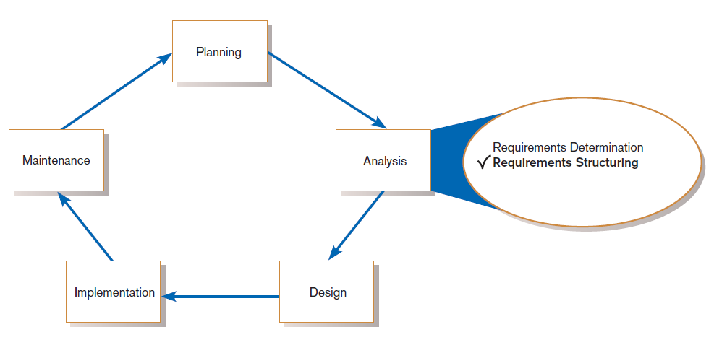
Conceptual Data Modeling (Cont.)
FIGURE 8-1
Systems development life cycle with analysis phase highlighted
Chapter 8
© 2014 Pearson Education, Inc. Publishing as Prentice Hall

Slide 6
The Conceptual Data Modeling Process
Develop a data model for the current system.
Develop a new conceptual data model that includes all requirements of the new system.
In the design stage, the conceptual data model is translated into a physical design.
Project repository links all design and data modeling steps performed during SDLC.
Chapter 8
© 2014 Pearson Education, Inc. Publishing as Prentice Hall

Slide 7
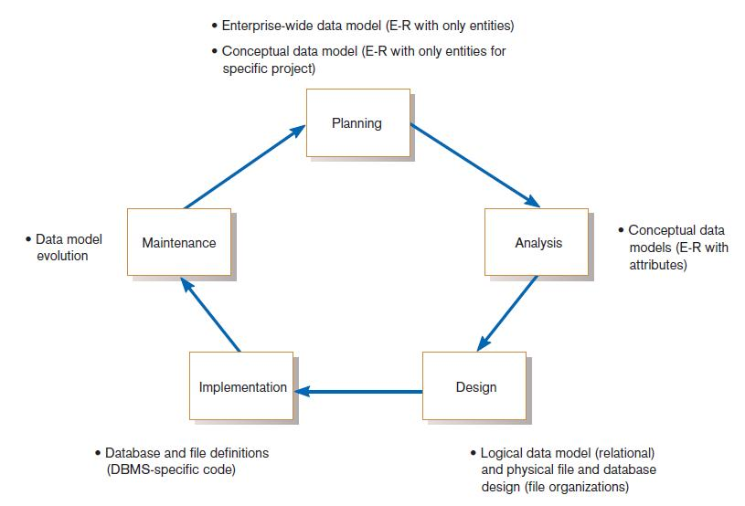
Conceptual Data Modeling (Cont.)
FIGURE 8-2
Relationship between data modeling and the SDLC
Chapter 8
© 2014 Pearson Education, Inc. Publishing as Prentice Hall

Slide 8
Deliverables and Outcome
Entity-relationship (E-R) diagram or UML class diagram
  Entities (or classes) – categories of data, represented as rectangles
  Relationships (or associations) – lines between the entities
Set of entries about data objects to be stored in repository project dictionary, or data modeling software
  Repository links data, process, and logic models of an information system.
  Data elements included in the data flow diagram (DFD) must appear in the data model and vice versa.
  Each data store in a process model must relate to business objects represented in the data model.
Chapter 8
© 2014 Pearson Education, Inc. Publishing as Prentice Hall

Slide 9
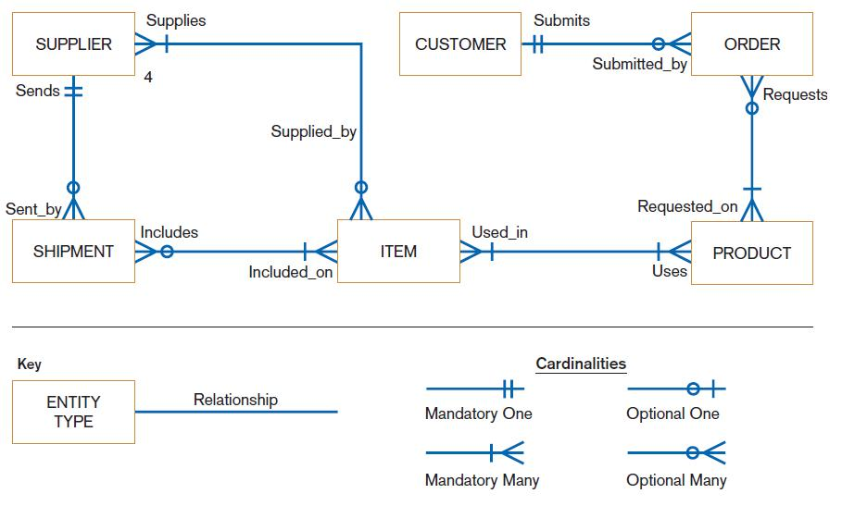
FIGURE 8-3
Sample conceptual data model
Chapter 8
© 2014 Pearson Education, Inc. Publishing as Prentice Hall

Slide 10
Gathering Information for Conceptual Data Modeling
Two perspectives on data modeling:
  Top-down approach for a data model is derived from an intimate understanding of the business.
  Bottom-up approach for a data model is derived by reviewing specifications and business documents.
Chapter 8
© 2014 Pearson Education, Inc. Publishing as Prentice Hall

Slide 11
Gathering Information for Conceptual Data Modeling (Cont.)
Requirements Determination Questions for Data Modeling:
  What are subjects/objects of the business?
    Data entities and descriptions
  What unique characteristics distinguish between subjects/objects of the same type?
    Primary keys
Chapter 8
© 2014 Pearson Education, Inc. Publishing as Prentice Hall

Slide 12
Gathering Information for Conceptual Data Modeling (Cont.)
  What characteristics describe each subject/object?
    Attributes and secondary keys
  How do you use the data?
    Security controls and user access privileges
  Over what period of time are you interested in the data?
    Cardinality and time dimensions
Chapter 8
© 2014 Pearson Education, Inc. Publishing as Prentice Hall

Slide 13
Gathering Information for Conceptual Data Modeling (Cont.)
  Are all instances of each object the same?
    Supertypes, subtypes, and aggregations
  What events occur that imply associations between objects?
    Relationships and cardinalities
  Are there special circumstances that affect the way events are handled?
    Integrity rules, cardinalities, time dimensions
Chapter 8
© 2014 Pearson Education, Inc. Publishing as Prentice Hall

Slide 14
Introduction to Entity-Relationship (E-R) Modeling
Entity-Relationship data model (E-R model): a detailed, logical representation of the entities, associations and data elements for an organization or business area
Entity-relationship diagram (E-R diagram): a graphical representation of an E-R model
Chapter 8
© 2014 Pearson Education, Inc. Publishing as Prentice Hall

Slide 15
Introduction to Entity-Relationship (E-R) Modeling
The E-R model is expressed in terms of:
  Data entities in the business environment.
  Relationships or associations among those entities.
  Attributes or properties of both the entities and their relationships.
Chapter 8
© 2014 Pearson Education, Inc. Publishing as Prentice Hall

Slide 16
Introduction to E-R Modeling (Cont.)
Entity: a person, place, object, event or concept in the user environment about which data is to be maintained
Entity type: collection of entities that share common properties or characteristics
Entity instance: single occurrence of an entity type
Chapter 8
© 2014 Pearson Education, Inc. Publishing as Prentice Hall

Slide 17
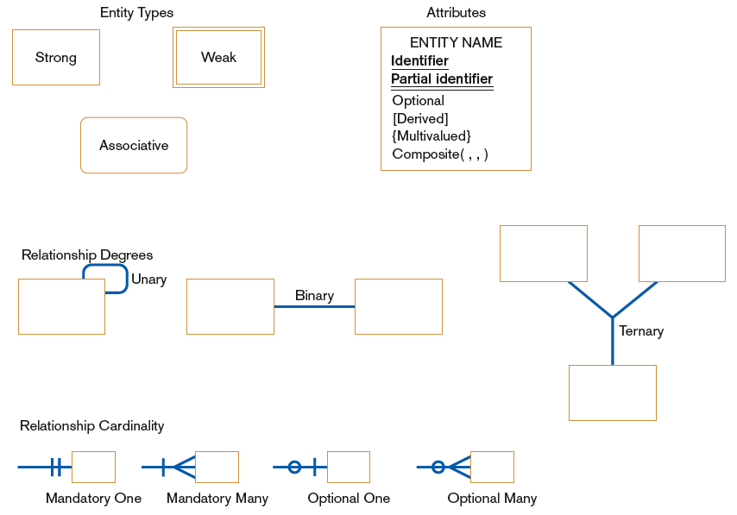
FIGURE 8-5 Basic E-R notation
Chapter 8
© 2014 Pearson Education, Inc. Publishing as Prentice Hall

Slide 18
Naming and Defining Entity Types
An entity type name should be:
  A singular noun.
  Descriptive and specific to the organization.
  Concise.
Event entity type should be named for the result of the event, not the activity or process of the event.
Chapter 8
© 2014 Pearson Education, Inc. Publishing as Prentice Hall

Slide 19
Naming and Defining Entity Types (Cont.)
An entity type definition:
  Includes a statement of what the unique characteristic(s) is (are) for each instance.
  Makes clear what entity instances are included and not included in the entity type.
  Often includes a description of when an instance of the entity type is created or deleted.
Chapter 8
© 2014 Pearson Education, Inc. Publishing as Prentice Hall

Slide 20
Naming and Defining Entity Types (Cont.)
For some entity types the definition must specify:
  When an instance might change into an instance of another entity type.
  What history is to be kept about entity instances.
Chapter 8
© 2014 Pearson Education, Inc. Publishing as Prentice Hall

Slide 21
Attributes
Attribute: a named property or characteristic of an entity that is of interest to the organization
  Naming an attribute: i.e. Vehicle_ID
  Place its name inside the rectangle for the associated entity in the E-R diagram.
Chapter 8
© 2014 Pearson Education, Inc. Publishing as Prentice Hall

Slide 22
Naming and Defining Attributes
An attribute name is a noun and should be unique.
To make an attribute name unique and for clarity, each attribute name should follow a standard format.
Similar attributes of different entity types should use similar but distinguishing names.
Chapter 8
© 2014 Pearson Education, Inc. Publishing as Prentice Hall

Slide 23
Naming and Defining Attributes (Cont.)
An attribute definition:
  States what the attribute is and possibly why it is important.
  Should make it clear what is included and what is not included.
  Contains any aliases or alternative names.
  States the source of values for the attribute.
Chapter 8
© 2014 Pearson Education, Inc. Publishing as Prentice Hall

Slide 24
Naming and Defining Attributes (Cont.)
An attribute definition should indicate:
  If a value for the attribute is required or optional.
  If a value for the attribute may change.
  Any relationships that attribute has with other attributes.
Chapter 8
© 2014 Pearson Education, Inc. Publishing as Prentice Hall

Slide 25
Candidate Keys and Identifiers.
Candidate key: an attribute (or combination of attributes) that uniquely identifies each instance of an entity type
Identifier: a candidate key that has been selected as the unique, identifying characteristic for an entity type
Chapter 8
© 2014 Pearson Education, Inc. Publishing as Prentice Hall

Slide 26
Candidate Keys and Identifiers (Cont.)
Selection rules for an identifier
  Choose a candidate key that will not change its value.
  Choose a candidate key that will never be null.
  Avoid using intelligent keys.
  Consider substituting single value surrogate keys for large composite keys.
Chapter 8
© 2014 Pearson Education, Inc. Publishing as Prentice Hall

Slide 27
Other Attribute Types
Multivalued attribute: an attribute that may take on more than one value for each entity instance
Repeating group: a set of two or more multivalued attributes that are logically related
Chapter 8
© 2014 Pearson Education, Inc. Publishing as Prentice Hall

Slide 28
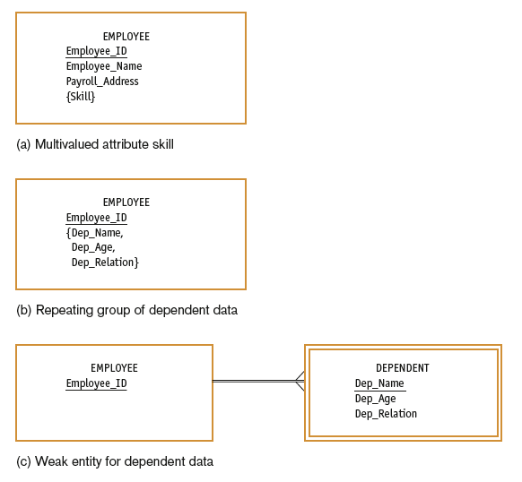
FIGURE 8-8
Multivalued attributes
and repeating groups
Chapter 8
© 2014 Pearson Education, Inc. Publishing as Prentice Hall

Slide 29
Other Attribute Types
Required attribute: an attribute that must have a value for every entity instance
Optional attribute: an attribute that may not have a value for every entity instance
Composite attribute: an attribute that has meaningful component parts
Derived attribute: an attribute whose value can be computed from related attribute values
Chapter 8
© 2014 Pearson Education, Inc. Publishing as Prentice Hall

Slide 30
Relationships
Relationship: an association between the instances of one or more entity types that is of interest to the organization
Degree: the number of entity types that participate in a relationship
Chapter 8
© 2014 Pearson Education, Inc. Publishing as Prentice Hall

Slide 31
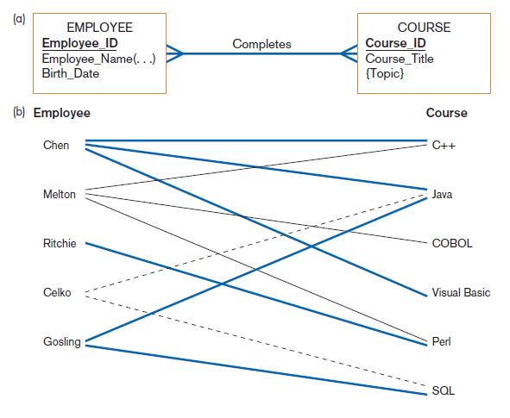
Figure 8-10
Relationship type and instances
(a) Relationship type (Completes)
(b) Relationship instances
Chapter 8
© 2014 Pearson Education, Inc. Publishing as Prentice Hall

Slide 32
Conceptual Data Modeling and the E-R Model
Unary relationship: a relationship between the instances of one entity type
  Also called a recursive relationship
Binary relationship: a relationship between instances of two entity types
  Most common type of relationship encountered in data modeling
Ternary relationship: a simultaneous relationship among instances of three entity types
Chapter 8
© 2014 Pearson Education, Inc. Publishing as Prentice Hall

Slide 33
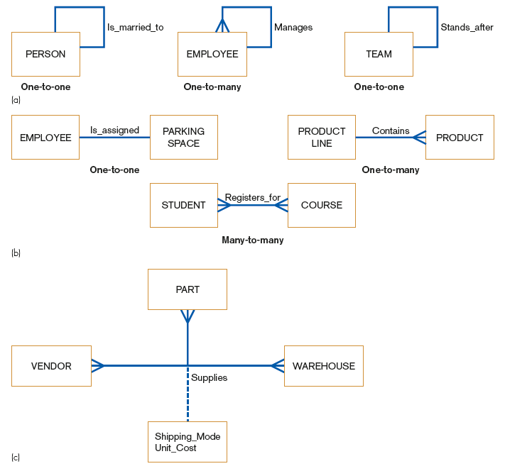
Unary relationships
FIGURE 8-11
Examples of relationships
of different degrees
Binary relationships
Ternary relationships
Chapter 8
© 2014 Pearson Education, Inc. Publishing as Prentice Hall

Slide 34
Cardinalities in Relationships
Cardinality: the number of instances of entity B that can (or must) be associated with each instance of entity A
Minimum Cardinality
  The minimum number of instances of entity B that may be associated with each instance of entity A
Maximum Cardinality
  The maximum number of instances of entity B that may be associated with each instance of entity A
Chapter 8
© 2014 Pearson Education, Inc. Publishing as Prentice Hall

Slide 35
Cardinalities in Relationships (Cont.)
Mandatory vs. Optional Cardinalities
  Specifies whether an instance must exist or can be absent in the relationship
Chapter 8
© 2014 Pearson Education, Inc. Publishing as Prentice Hall

Slide 36
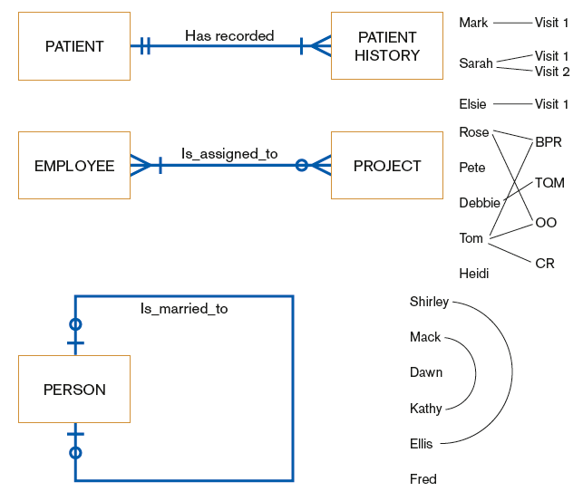
FIGURE 8-14 Examples of cardinality constraints
(a) Mandatory cardinalities
(b) One optional, one mandatory cardinality
(c) Optional cardinalities
Chapter 8
© 2014 Pearson Education, Inc. Publishing as Prentice Hall

Slide 37
Naming and Defining Relationships
A relationship name is a verb phrase; avoid vague names.
A relationship definition:
  Explains what action is to be taken and possibly why it is important.
  Gives examples to clarify the action.
Chapter 8
© 2014 Pearson Education, Inc. Publishing as Prentice Hall

Slide 38
Naming and Defining Relationships (Cont.)
A relationship definition should:
  Explain any optional participation.
  Explain the reason for any explicit maximum cardinality other than many.
  Explain any restrictions on participation in the relationship.
  Explain the extent of history that is kept in the relationship.
  Explain whether an entity instance involved in a relationship instance can transfer participation to another relationship instance.
Chapter 8
© 2014 Pearson Education, Inc. Publishing as Prentice Hall

Slide 39
Associative Entities
Associative Entity: an entity type that associates the instances of one or more entity types and contains attributes that are peculiar to the relationship between those entity instances
  Sometimes called a gerund
The data modeler chooses to model the relationship as an entity type.
Chapter 8
© 2014 Pearson Education, Inc. Publishing as Prentice Hall

Slide 40
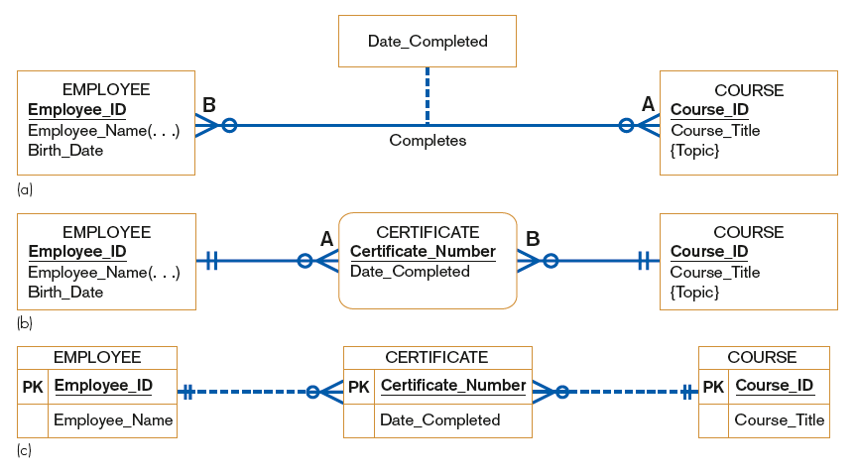
FIGURE 8-15 An associative entity
Attribute on a relationship
An associative entity (CERTIFICATE)
An associative entity using Microsoft Visio®
Chapter 8
© 2014 Pearson Education, Inc. Publishing as Prentice Hall

Slide 41
Summary of Conceptual Data Modeling with E-R Diagrams
The purpose of E-R diagramming is to capture the richest possible understanding of the meaning of the data necessary for an information system or organization.
Chapter 8
© 2014 Pearson Education, Inc. Publishing as Prentice Hall

Slide 42
Representing Supertypes and Subtypes
Subtype: a subgrouping of the entities in an entity type
  Is meaningful to the organization
  Shares common attributes or relationships distinct from other subgroupings
Supertype: a generic entity type that has a relationship with one or more subtypes
Chapter 8
© 2014 Pearson Education, Inc. Publishing as Prentice Hall

Slide 43
Representing Supertypes and Subtypes (Cont.)
Business Rules for Supertype/subtype Relationships:
  Total specialization specifies that each entity instance of the supertype must be a member of some subtype in the relationship.
  Partial specialization specifies that an entity instance of the supertype does not have to belong to any subtype, and may or may not be an instance of one of the subtypes.
Chapter 8
© 2014 Pearson Education, Inc. Publishing as Prentice Hall

Slide 44
Representing Supertypes and Subtypes (Cont.)
  Disjoint rule specifies that if an entity instance of the supertype is a member of one subtype, it cannot simultaneously be a member of any other subtype.
  Overlap rule specifies that an entity instance can simultaneously be a member of two (or more) subtypes.
Chapter 8
© 2014 Pearson Education, Inc. Publishing as Prentice Hall

Slide 45
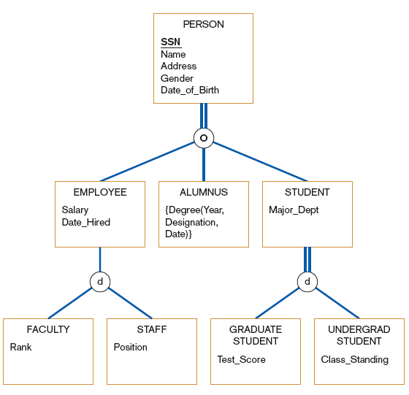
FIGURE 8-19
Example of supertype/subtype hierarchy
Chapter 8
© 2014 Pearson Education, Inc. Publishing as Prentice Hall

Slide 46
Business Rules
Business rules: specifications that preserve the integrity of the logical data model
  Captured during requirements determination
  Stored in CASE repository as they are documented
Chapter 8
© 2014 Pearson Education, Inc. Publishing as Prentice Hall

Slide 47
Business Rules (Cont.)
Four basic types of business rules are:
  Entity integrity: unique, non-null identifiers
  Referential integrity constraints: rules governing relationships between entity types
  Domains: constraints on valid values for attributes
  Triggering operations: other business rules that protect the validity of attribute values
Chapter 8
© 2014 Pearson Education, Inc. Publishing as Prentice Hall

Slide 48
Domains
Domain: the set of all data types and values that an attribute can assume
Several advantages
  Verify that the values for an attribute are valid
  Ensure that various data manipulation operations are logical
  Help conserve effort in describing attribute characteristics
Chapter 8
© 2014 Pearson Education, Inc. Publishing as Prentice Hall

Slide 49
Triggering Operations
Trigger: an assertion or rule that governs the validity of data manipulation operations such as insert, update and delete
Chapter 8
© 2014 Pearson Education, Inc. Publishing as Prentice Hall

Slide 50
Triggering Operations
Includes the following components:
  User rule: statement of the business rule to be enforced by the trigger
  Event: data manipulation operation that initiates the operation
  Entity Name: name of entity being accessed or modified
  Condition: condition that causes the operation to be triggered
  Action: action taken when the operation is triggered
Chapter 8
© 2014 Pearson Education, Inc. Publishing as Prentice Hall

Slide 51
Role of Packaged Conceptual Data Models – Database Patterns
Packaged data models provide generic models that can be customized for a particular organization’s business rules.
Universal data models are templates for
  one or more core subject areas such as:
    Customers, products, accounts, documents
  and/or core business functions such as:
    Purchasing, accounting, receiving, etc.
Chapter 8
© 2014 Pearson Education, Inc. Publishing as Prentice Hall

Slide 52
Role of Packaged Conceptual Data Models – Database Patterns (Cont.)
Industry-specific data models are designed to be used by organizations within specific industries.
These models are based on the premise that data model patterns for organizations are similar within a particular industry.
Chapter 8
© 2014 Pearson Education, Inc. Publishing as Prentice Hall

Slide 53
Benefits of Database Patterns and Packaged Data Models
Dramatically reduced implementation times and costs
  Provides a starting point for asking requirements questions
Higher-quality models
  Represent “best practice” data modeling techniques and data model components whose quality often exceeds that which can be achieved by internal development teams, given typical organizational pressures
Chapter 8
© 2014 Pearson Education, Inc. Publishing as Prentice Hall

Slide 54
Electronic Commerce Application: Conceptual Data Modeling
Five general categories of information were identified for Pine Valley Furniture’s WebStore.
Next step was to define each item.
The final step was to identify the interrelationships between the four entities.
Chapter 8
© 2014 Pearson Education, Inc. Publishing as Prentice Hall

Slide 55
Summary
In this chapter you learned how to:
  Concisely define each of the following key data modeling terms: entity type, attribute, multivalued attribute, relationship, degree, cardinality, business rule, associative entity, trigger, supertype, subtype.
  Draw an entity-relationship (E-R) diagram to represent common business situations.
  Explain the role of conceptual data modeling in the overall analysis and design of an information system.
Chapter 8
© 2014 Pearson Education, Inc. Publishing as Prentice Hall

Slide 56
Summary (Cont.)
In this chapter you learned how to:
  Explain the role of prepackaged database models (patterns) in data modeling.
  Distinguish between unary, binary, and ternary relationships and give an example of each.
  Define four basic types of business rules in a conceptual data model.
  Relate data modeling to process and logic modeling as different views of describing an information system.
Chapter 8
© 2014 Pearson Education, Inc. Publishing as Prentice Hall

Slide 57

Copyright © 2014 Pearson Education, Inc.
Publishing as Prentice Hall

